Slide 1

Let’s stay safe in traffic together!

Slide 2

What is Tampere Tram like?

Slide 3
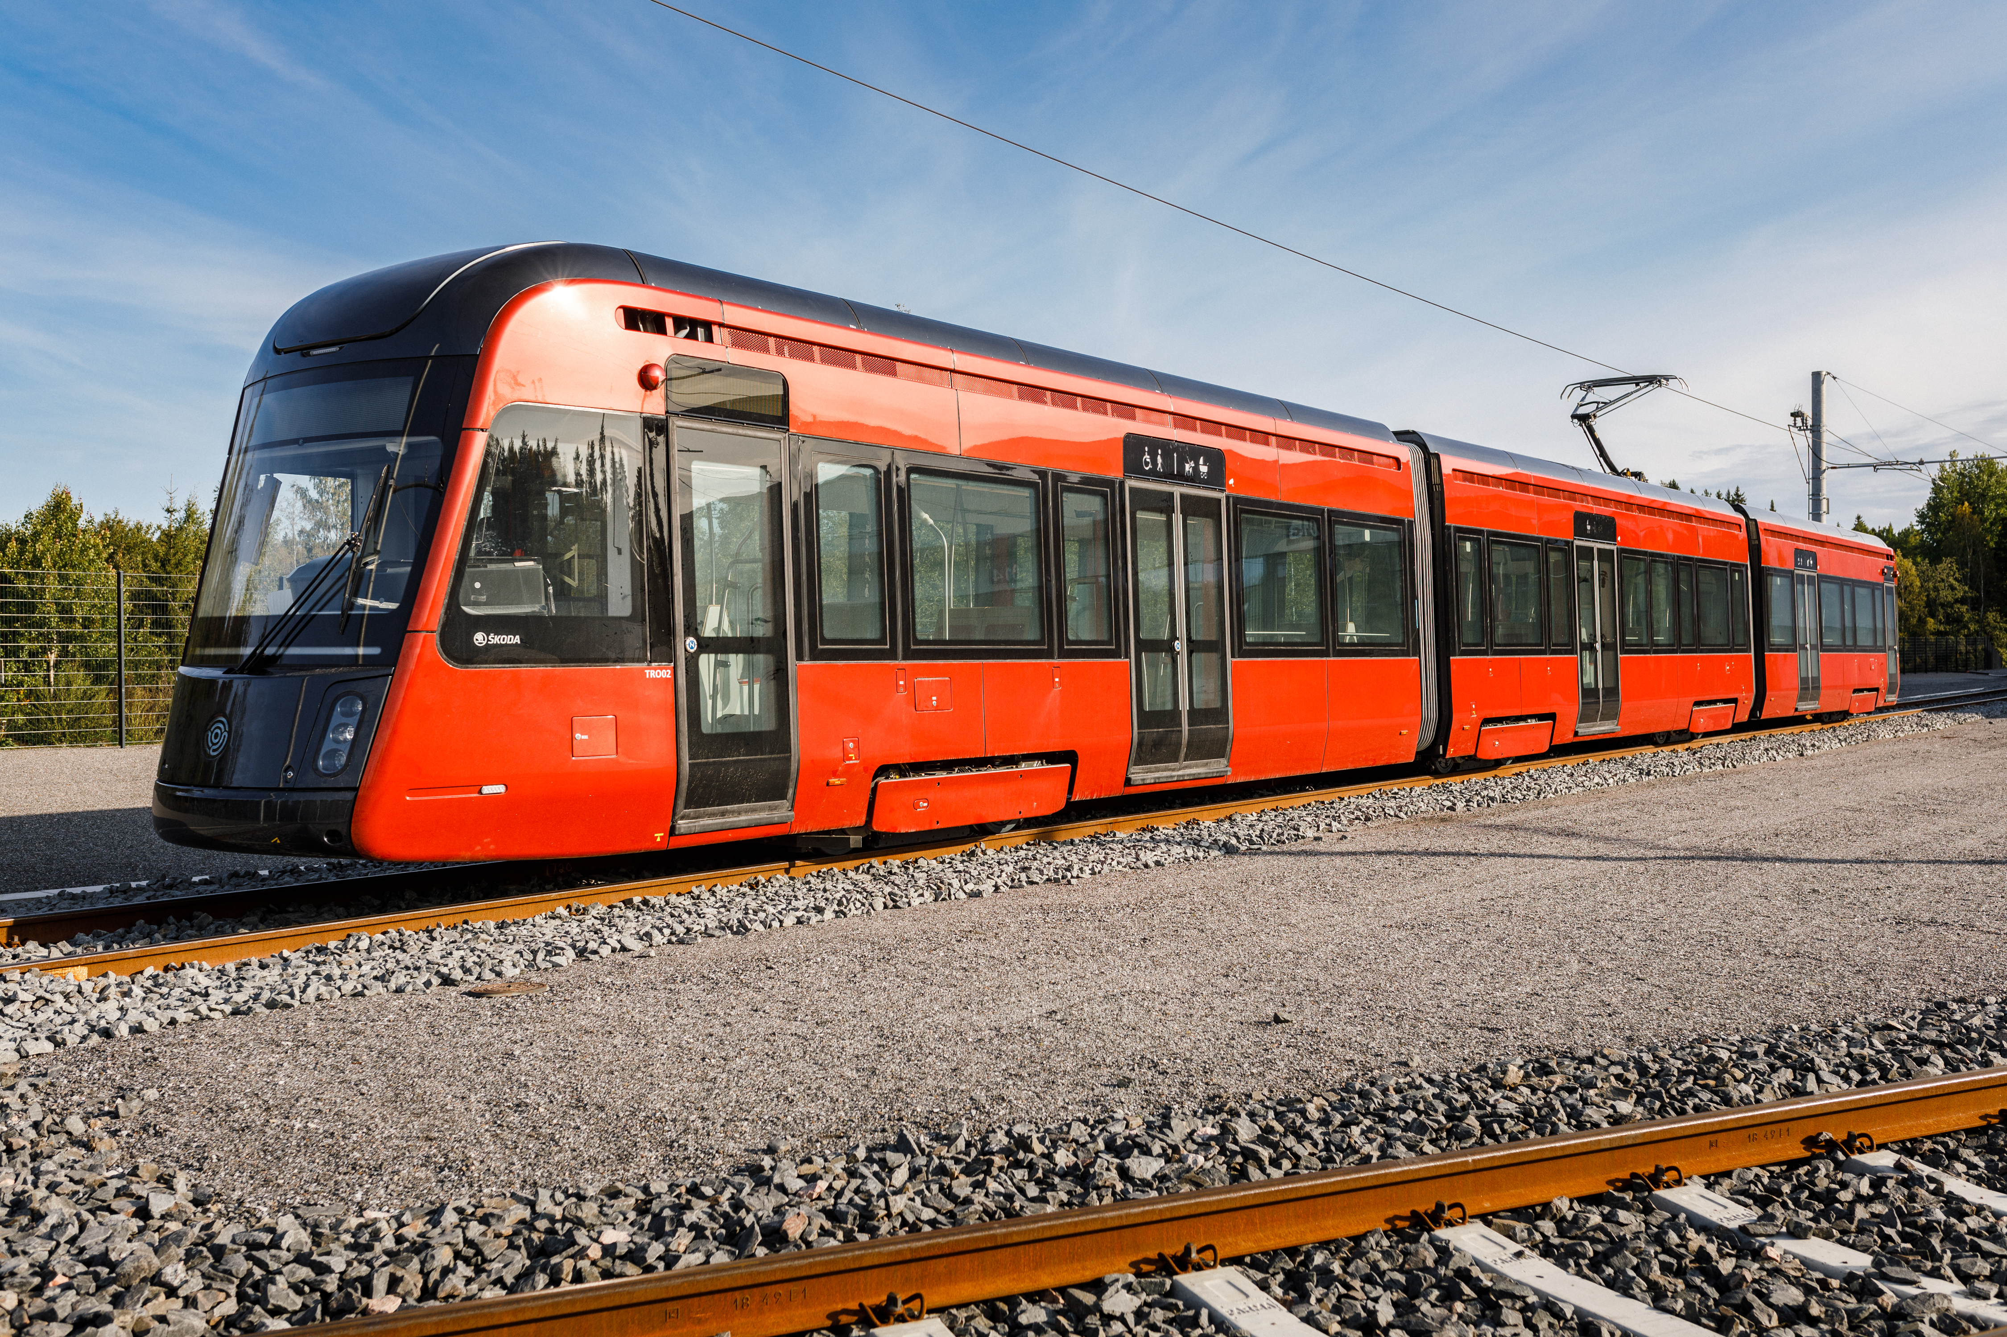
Tampere Tram
One tram can carry three busloads of passengers (264 people). There are 104 seats in one tram.
The tram runs every 7.5 minutes during the day. In the center, the shift is 3–4 minutes.
Accessible and spacious
Air conditioned and well lit
Environment friendly
Ratikka is part of the Nysse family. You can travel by tram and bus using the same ticket.
Tampere has 28 trams.
Trams are manufactured at Škoda Transtech's factory, in Otanmäki, Kajaani.

Slide 4
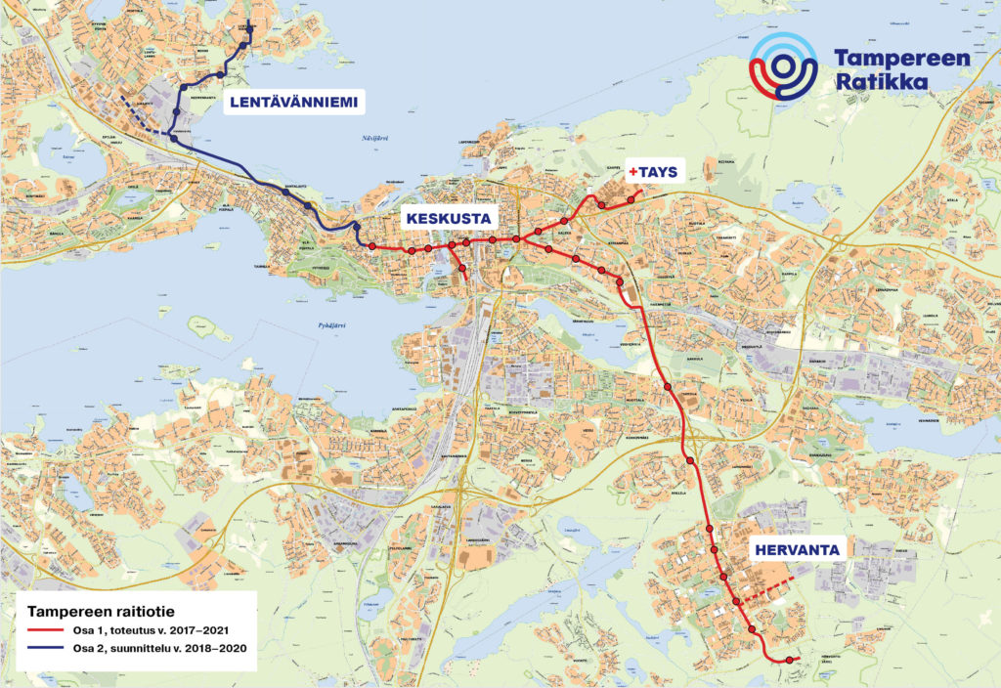

Tram Routes:
Line 1 from Kaupin kampus to Santalahti includes 20 stops:
Kaupin kampus, Tays, Hippos, Kalevan kirkko, Sammonaukio, Tulli, Rautatieasema, Koskipuisto, Keskustori, Tuulensuu, Pyynikintori, Särkänniemi, Tikkutehdas, Santalahti, Hiedanta, Tehdas, Niemen kartano, Niemenranta, Lentävänniemi, Pyhällönpuisto
Line 3 from Hervantajärvi to Sorin aukio includes 17 stops :
Hervantajärvi, Etelä-Hervanta, Hervannan kampus, Hervantakeskus, Opiskelija, Pohjois-Hervanta, Hallila, Turtola, Hakametsä, Kalevanrinne, Uintikeskus, Kaleva, Sammonaukio, Tulli, Rautatieasema, Koskipuisto, Sorin aukio
The route is expanding to Linnainmaa and Pirkkala.
The total length of the tram route is 17,9 km.

Slide 5
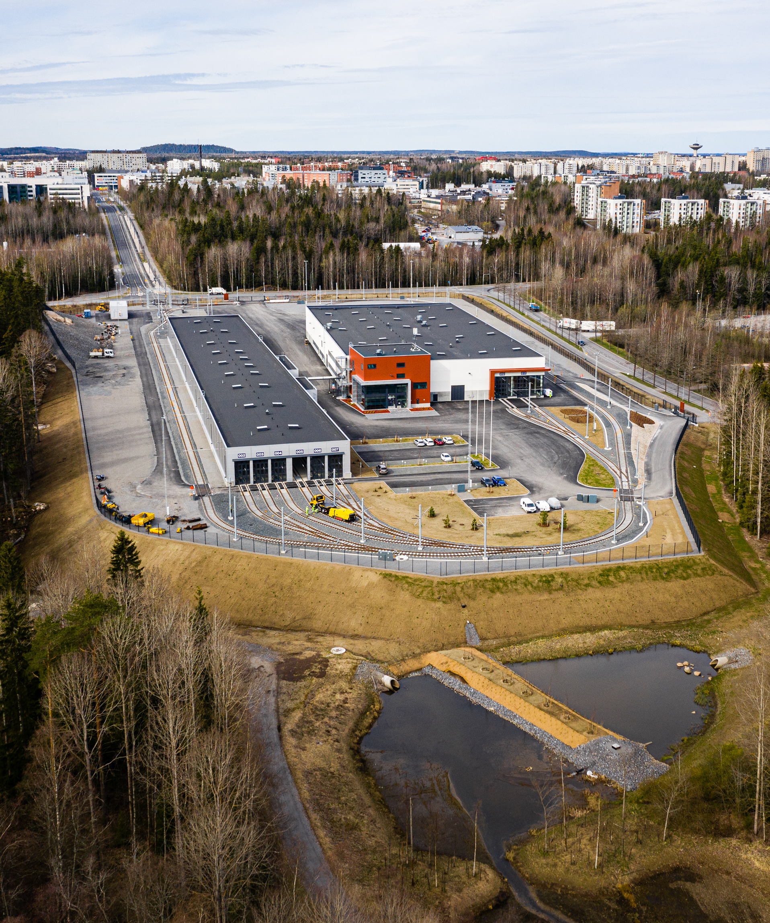
Tram Depot
REPAIR HALL
STORAGE HALL
The depot is the home of the trams, where they are based and maintained.
The depot is in Hervanta.
The depot includes two main buildings: storage hall and the repair hall.
The depot operates around the clock and more than hundred people use it daily.
Tram drivers, traffic controllers, track and tram maintenance personnel, cleaners and employees of Tampere Tramway work at the depot.
Tram depot in Hervanta is the home of all trams!

Slide 6

How do I cross the tramway safely?

Slide 7
Crossing the tramway safely – Keep your eyes open!
Always cross the tramway only at pedestrian crossings or designated crossovers.
Never bypass a stopped tram directly in front of it or behind it, because
the front of the tram is high and the driver may not see you
the driver driving in the other lane cannot see you from behind the tram
Watch a video about tramway crossings!

Slide 8
Crossing the tramway safely – Keep your eyes open!
How to cross tramway safely:
Stop and take it easy.
Look both ways and make sure there are no trams or cars coming.
Listen and focus on crossing the road.
Cross tramway on foot. Others have time to notice you better and you do not slip or trip when crossing.

Slide 9
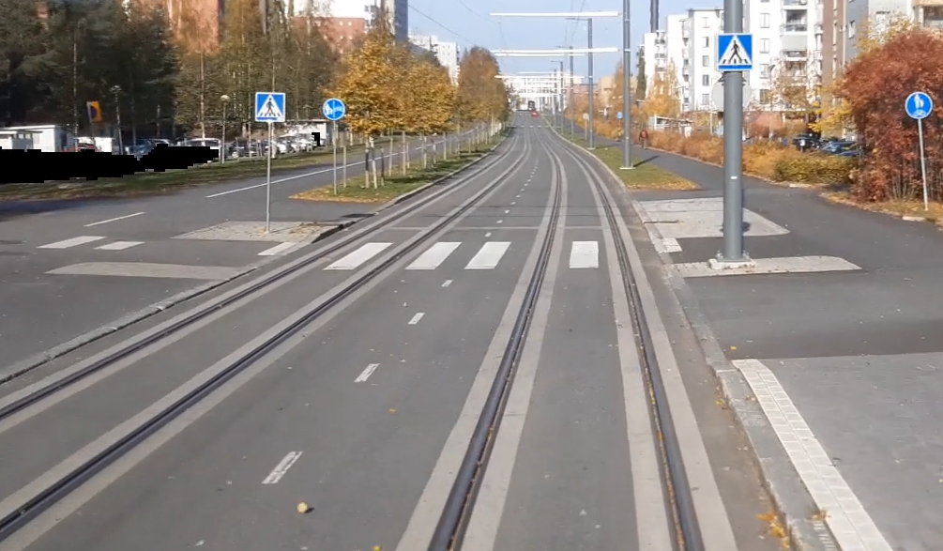
Pedestrian crossing
PEDESTRIAN CROSSING SIGN
There are pavement markings (a zebra crossing) across the road and track.
The tram will yield to you at a pedestrian crossing. Make sure that the tram is stopped. Tram is very slow to stop.
Usually, there are also traffic lights at a pedestrian crossing. Before crossing the road, make sure that the light is green for you.
PEDESTRIAN CROSSING PAVEMENT MARKINGS
(WHITE LINES)

Slide 10
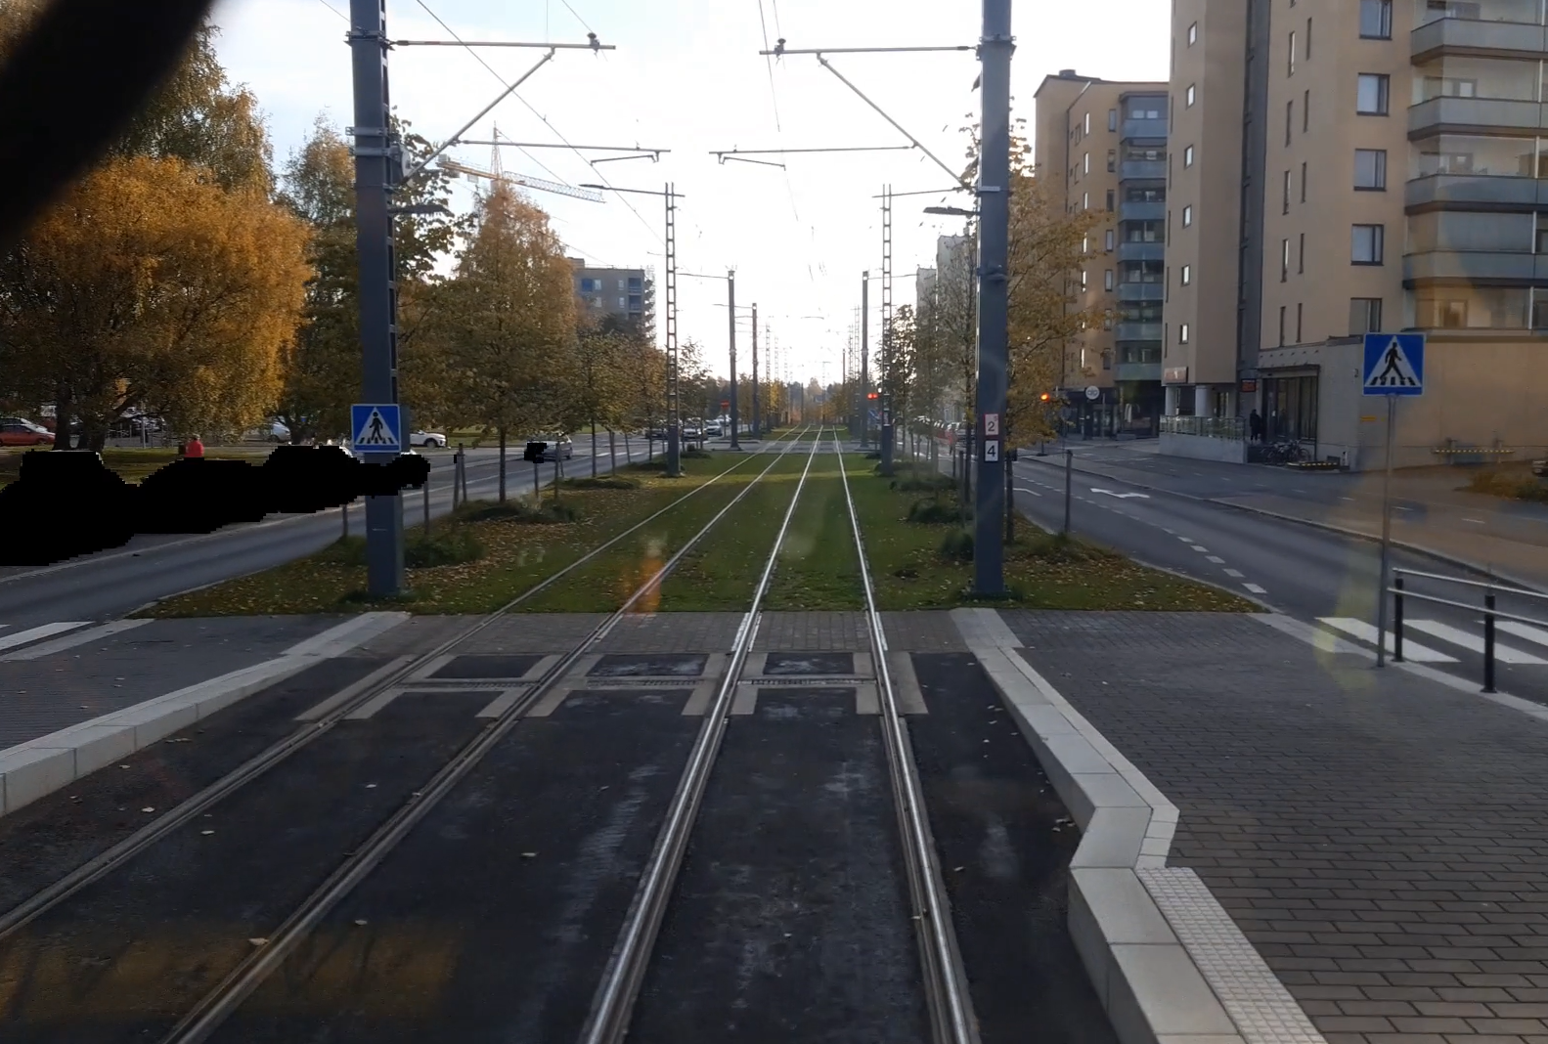
Designated crossover
At designated crossovers, you must give way to trams, buses and other approaching vehicles. Always wait calmly for the tram and other vehicles to pass before crossing the road.
At designated crossover there are no pavement markings running across the road and track.
You can recognize the designated crossover by the lowered curb.
A LOWERED CURB
NO PAVEMENT MARKINGS

Slide 11
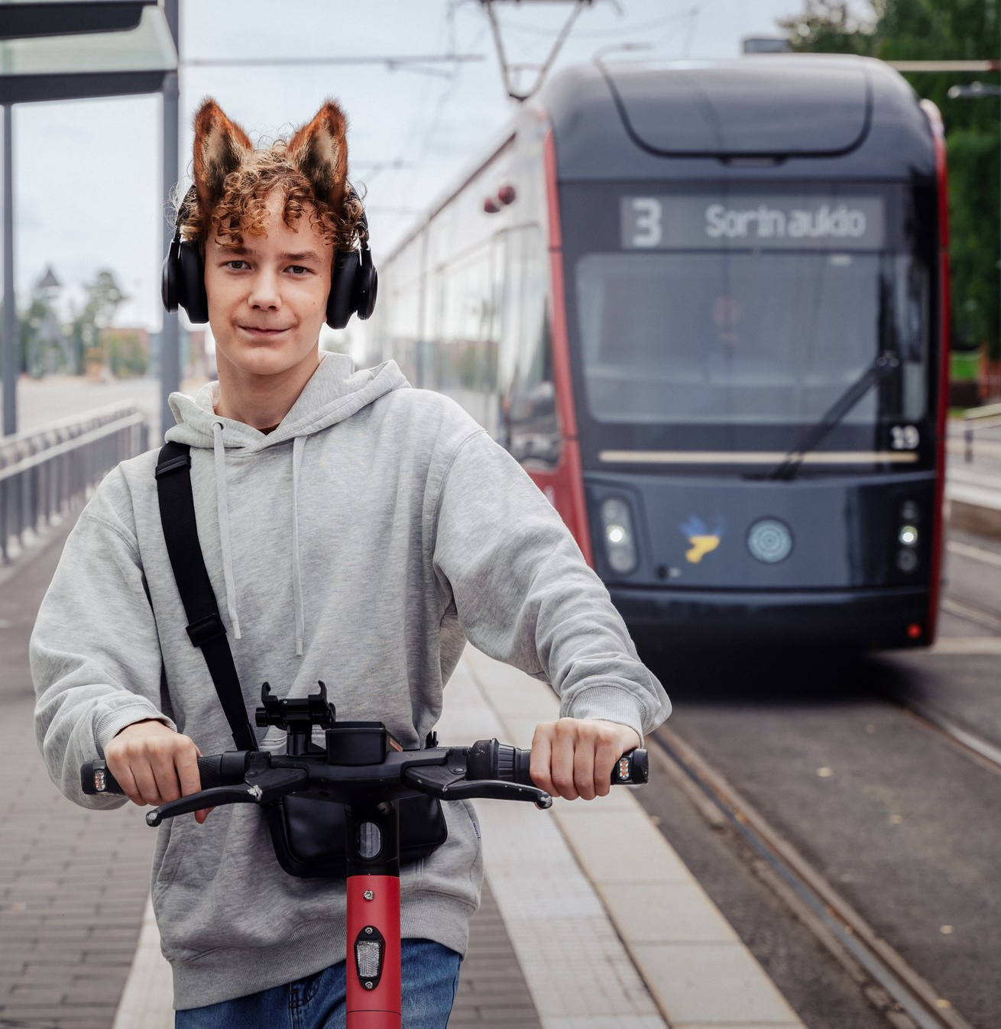
10 things to remember
Always cross the tramway only at pedestrian crossing or designated crossovers: Stop – look both ways – listen – cross the tramway on foot.
Never bypass a stopped tram directly in front of it or behind it.
The tram weights about the same as ten elephants. It is very slow to stop. Never rush in front of the tram.
The tram can’t swerve around you, because it runs on track.
In addition to trams, maintenance vehicles also move on the track, so always be careful when crossing the track!
Let´s stay save in traffic together

Slide 12
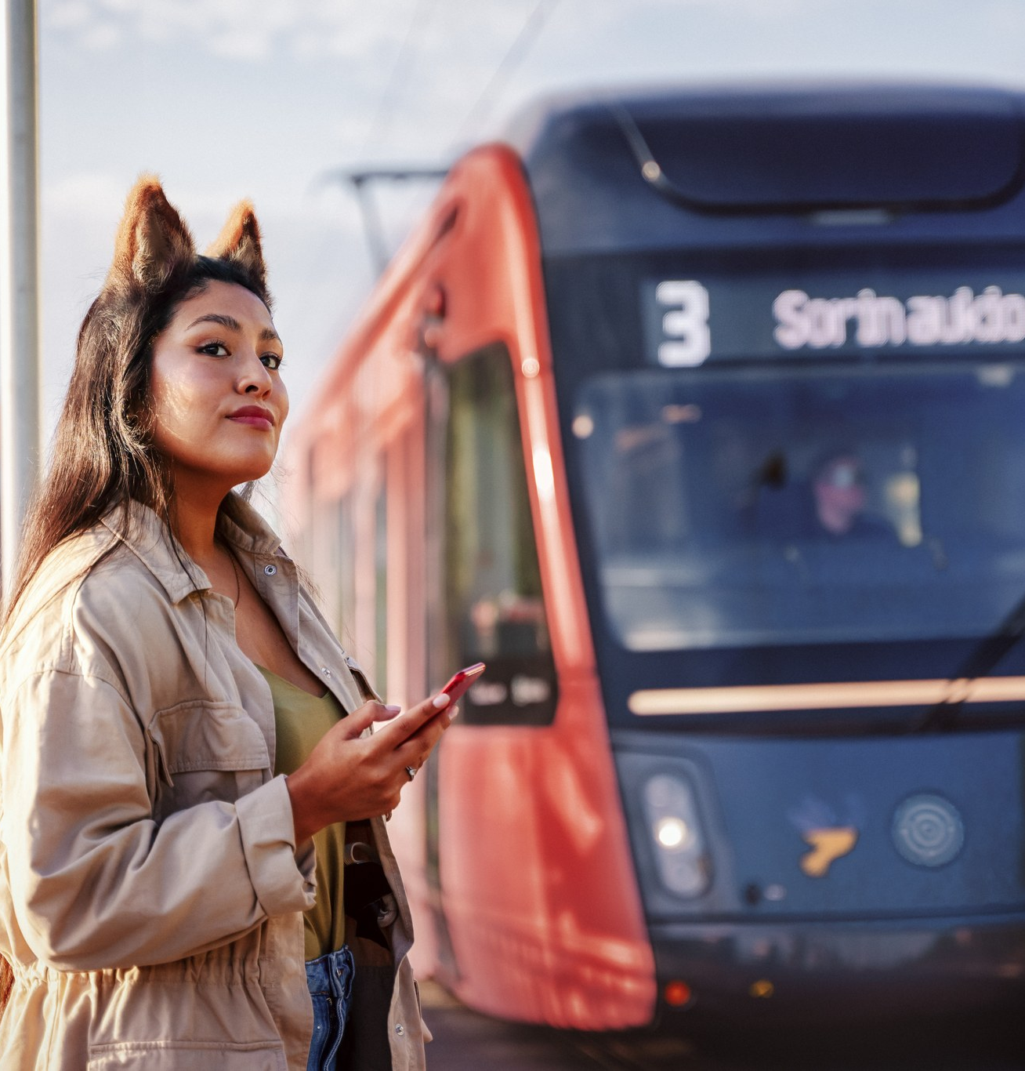

10 things to remember
The tram is silent, so you don’t necessarily hear it in advance.
Waiting for the tram is safest when you stay or walk behind the white pavement.
Do not try to touch the moving tram to avoid injuring yourself on the sharp parts of the tram.
Track is not a place for playing or hanging about.
Never take photos or selfies on the track.
Wait for the tram behind the white pavement.

Slide 13
Thank you! Let’s stay safe in traffic together!

